Slide 1
CHARITY project overview
Ferran Diego
Telefonica Investigacion y Desarrollo
SWForum webinar
21/02/23

Slide 2
Augmented / Virtual Reality…
Not a new (but fascinating) concept
Ability to create the illusion of the presence of people, objects or landscapes offers a wide variety of exciting applications
Demanding requirements on the connectivity due to large data volumes to transmit in high-speed with low latencies
No wide uptake as of today
Networks
Processing mechanisms
User equipment, e.g. displays, motion tracking
… but recent advances now seem to indicate that significant progress could be made

Slide 3
CHARITY in a nutshell
Full project title: Cloud for Holography and Cross Reality
EC-funded project (Horizon 2020), 01/21-12/23, Budget 5 m Euro
CHARITY will develop a complete framework for enabling immersive communication, i.e. Virtual Reality or Holography, to support day-to-day business operations, social events, and general lifestyle.
CHARITY leverages an innovative cloud architecture that exploits edge solutions, a computing and network continuum autonomous orchestration, application-driven interfacing, mechanisms for smart, adaptive and efficient resource management, community involvement, and compatibility with infrastructure vendors.

Slide 4
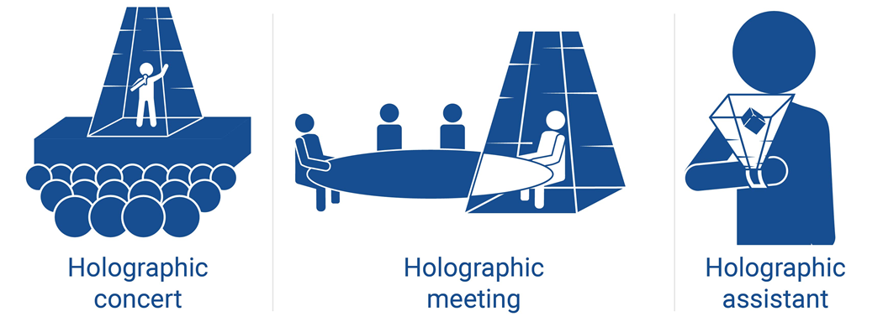
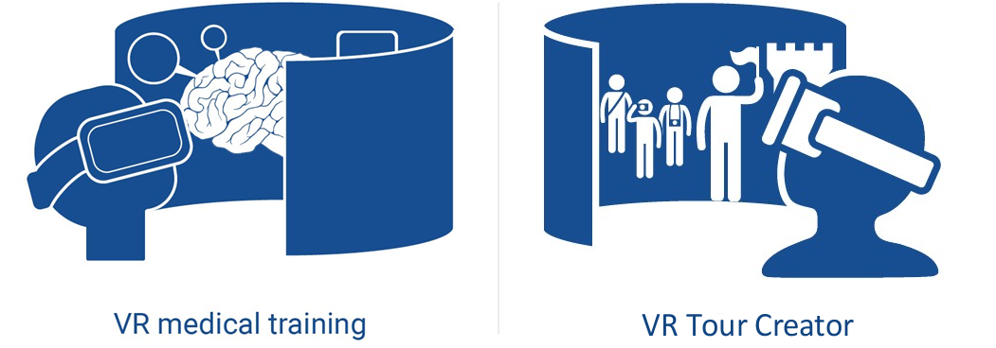
Use Cases
#1: Real-time Holographic applications
#2: Immersive virtual training
#3: Mixed Reality interactive application

Slide 5
Project objectives
Achieve autonomicity in orchestrating network, compute, and storage resources in hybrid edge/cloud infrastructures
Provide holistic support for the orchestration of advanced media solutions
End-to-end application lifecycle management
Develop highly interactive and collaborative services and applications

Slide 6
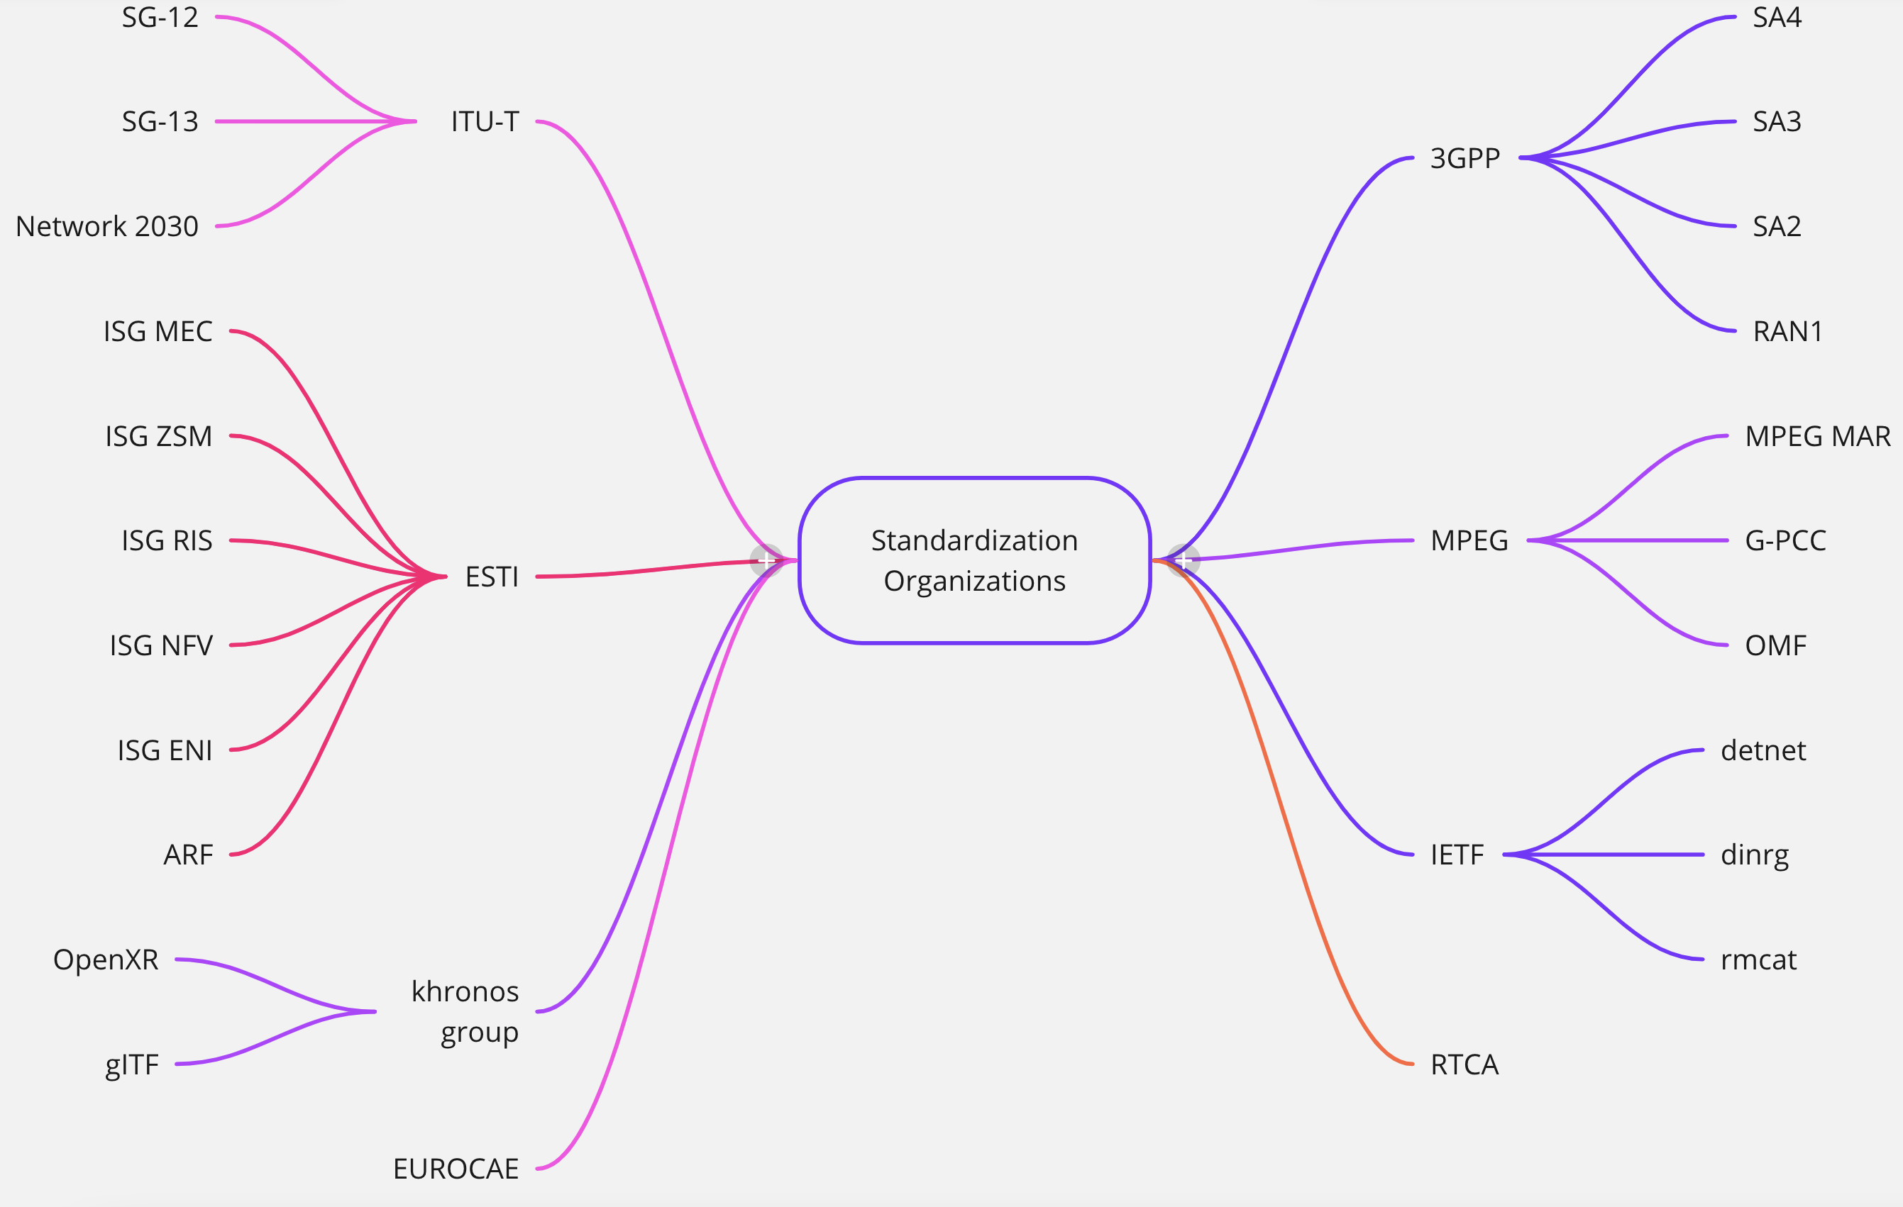
Standardization on a multidisciplinary domain

Slide 7
Identification of Contributions
There are 4 types of standardization contributions (order from mayor to minor):
Complete Specification
Build from scratch a new specification and being responsible of the editing
Contribution to an active specification
Check current active specifications to add a section/improvement
Proof of Concept (PoC):
Create a related demonstrator, showcase in a conference and create an inform
Member:
Be part of a standarization body, attend meetings and checking contributions that could benefit the project

Slide 8
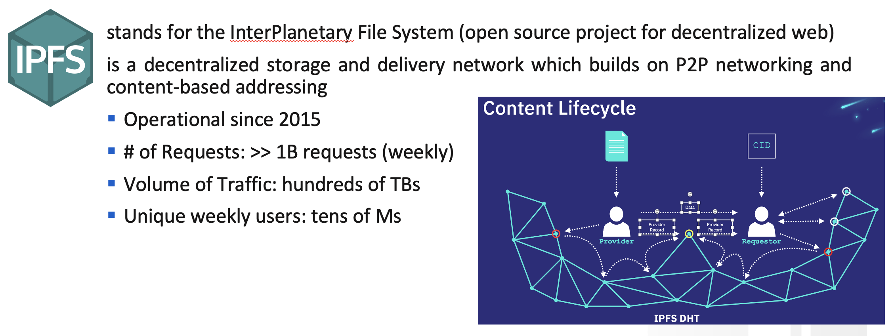
Only Standardization
Open source communities/projects are technological enablers and key for project development

Slide 9
Thank you for your attention!
www.charity-project.eu
@CharityProj
Acknowledgment: The research conducted by CHARITY receives funding from the European Commission H2020 programme under Grant Agreement Nº 101016509. The European Commission has no responsibility for the content of this presentation.

